Slide 1


DEPARTMENT OF ARITIFICIAL INTELLIGENCE AND DATA SCIENCE
SCHOOL OF COMPUTING
10214AD601 MINOR PROJECT -1
SUMMER SEMESTER(2024-2025)
SEMESTER END PROJECT VIVA VOCE EXAMINATIONS
“PRECISION DIABETES PREDICTION USING ENSEMBLE MACHINE LEARNING MODELS”
SUPERVISED BY
PRESENTED BY
Ms. I.FARZHANA , ME,
Assistant Professor
1.RAHUL L (VTU21369) (22UEAD0050)
2.RAVI PRASAD G (VTU23521) (22UEAD0052)
3.ANBARASU S (VTU26985) (22UEAD2001)

Slide 2
OVERVIEW
ABSTRACT
OBJECTIVES
TIMELINE OF THE PROJECT
INTRODUCTION
LITERATURE REVIEW
DESIGN AND METHODOLOGIES
IMPLEMENTATION
TESTING
INPUT AND OUTPUT
CONCLUSION
FUTURE ENHANCEMENTS
SOCIETAL IMPACT OF PROJECT
PLAGIARISM REPORT
REFERENCES

Slide 3
ABSTRACT
The rising worldwide incidence of diabetes underscores the critical need for innovative tools that facilitate early detection and management.
This project introduces a web application designed to predict the likelihood of diabetes onset, leveraging advanced machine learning algorithms.
The primary objective is to empower users with a user-friendly platform for personalized risk assessment.
This project employed a comprehensive approach involving the analysis of a diverse dataset, considering key health indicators and lifestyle factors.
The machine learning model, especially designed for diabetes prediction, demonstrates promising accuracy and reliability.
The development of the user-centric web application prioritizes simplicity and accessibility.
This project can serve as a valuable resource for healthcare providers by offering insights into patients' risk profiles and able to identification of risk factors in early stage which facilate the early treatment for the individuals.
Easy design elements facilitate easy data input, ensuring a problem less experience for users from different backgrounds.
This project represents a significant advancement in diabetes management and easy accessibility of the early diabetes prediction to all people in a easier way.

Slide 4
OBJECTIVES
Objective of the Project:
Early Detection: The primary objective is to develop a predictive model that can identify individuals at risk of developing diabetes before the onset of clinical symptoms.
Healthcare Improvement: Improve healthcare outcomes by enabling early intervention and personalized prevention strategies tailored to high-risk individuals.
Data Integration: Integrate diverse datasets including clinical records, genetic information, lifestyle factors, and biomarkers to enhance the accuracy and reliability of the predictive model.
Technology Application: Apply advanced machine learning algorithms and predictive analytics to leverage big data for diabetes risk assessment.
Scope of the Project:
Data Collection and Integration: Collect and preprocess diverse datasets relevant to diabetes risk factors.
Integrate structured and unstructured data sources to capture comprehensive information.
Model Development: Develop machine learning models capable of predicting diabetes risk based on selected variables. Explore and implement feature selection techniques to identify the most relevant predictors.
Evaluation and Validation: Evaluate model performance using appropriate metrics such as accuracy, sensitivity, specificity, and area under the ROC curve (AUC).
Implementation and Deployment: Implement the validated model into a user-friendly application or interface accessible to healthcare providers and potentially to individuals for self-assessment

Slide 5
TIMELINE OF THE PROJECT
Task Name | Jun 1 | July 1 | Aug 1 | Sep 1 | Oct 1 | Oct 15
Planning
Research
Design
Implementation
Follow up

Slide 6
INTRODUCTION
Introduction:
Diabetes is a chronic condition characterized by elevated levels of glucose in the blood. With its increasing prevalence globally, early detection and management of diabetes have become critical in preventing its progression and reducing associated health complications. Early diabetes predictors play a pivotal role in identifying individuals at risk before the onset of the disease, enabling timely interventions and lifestyle adjustments, this can significantly influence the course of the disease.
Understanding Diabetes:
Diabetes appears mainly in two types: Type 1 and Type 2. Type 1 diabetes is an autoimmune disorder where the body's immune system destroys insulin-producing cells in the pancreas. In contrast, Type 2 diabetes is characterized by insulin resistance and reduced insulin production. While both types need diligent monitoring and treatment, Type 2 diabetes is frequently linked to lifestyle choices and can be impacted by early intervention and prevention strategies.
The Importance of Early Prediction:
Early diabetes prediction involves assessing various risk factors and biomarkers to identify individuals who may develop diabetes before clinical symptoms appear. This forward-thinking approach is crucial for various reasons.
Prevention: Early intervention can prevent or delay the onset of diabetes through lifestyle changes such as improved diet, increased physical activity, and weight management.
Reduction of Complications: Identifying risk factors early helps in minimizing the risk of severe complications such as cardiovascular disease, neuropathy, and retinopathy.
Improved Outcomes: Early diagnosis enables more effective management of blood glucose levels, leading to better long-term health outcomes.

Slide 7
LITERATURE REVIEW
Author’s Name | Paper name and publication details | Year of publication | Main content of the paper
A. Sheik Abdullah, V. Naga Pranava Shashank and D. Altrin Lloyd Hidson | Disseminating the Risk Factors With Enhancement in Precision Medicine Using Comparative Machine Learning Models for Healthcare Data, IEEE | 2024 | The paper shows how machine learning models, such as SVM and Decision Trees, improve predictions for diseases like cancer and diabetes. It emphasizes the need for different methods for various conditions and highlights the importance of addressing dataset biases to ensure model reliability
Hakim El Massari, Zineb Sabouri, Sajida Mhammedi and Noreddine Gherabi | Diabetes Prediction Using Machine Learning Algorithms and Ontology, IEEE | 2022 | Machine learning is transforming industries, including healthcare, by improving chronic disease management like diabetes. The Semantic Web, particularly ontology, enhances concept processing and relationships. This analysis shows ontology-based classification methods outperform traditional machine learning methods in accuracy.

Slide 8
Author’s Name | Paper name and publication details | Year of publication | Main content of the paper
Nikos Fazakis , Otlia Kocsis , EliasDritsasa , Sotiris Alexiou, NikosFakotakisAnd Konstaninons Moustakas , | Machine Learning Tools for Long-Term Type 2 Diabetes Risk Prediction, (IEEE Access) | 2021 | This study used ensemble algorithms on the ELSA database to predict Type 2 Diabetes (T2DM) risk, achieving better accuracy than traditional methods. Future research will focus on handling missing data, feature selection, and advanced machine learning models to enhance predictions
KM Jyoti Rani (IMEC) | Diabetes Prediction Using Machine Learning,International Journal of Scientific Research in Computer Science, Engineering and Information Technology (IJSRCSEIT) | 2020 | Early diabetes detection is crucial. This study developed a system using five machine learning algorithms, achieving 99% accuracy with the Decision Tree algorithm on the John Diabetes Database. The system could be adapted for predicting other diseases and improved with additional machine learning techniques.

Slide 9
DESIGN AND METHODOLOGIES
MODULE 1: Diabetes dataset
Collection of data
Proceesing data
MODULE 2: Decision Tree Algorithm
Using Decision Tree algorithm
The output

Slide 10
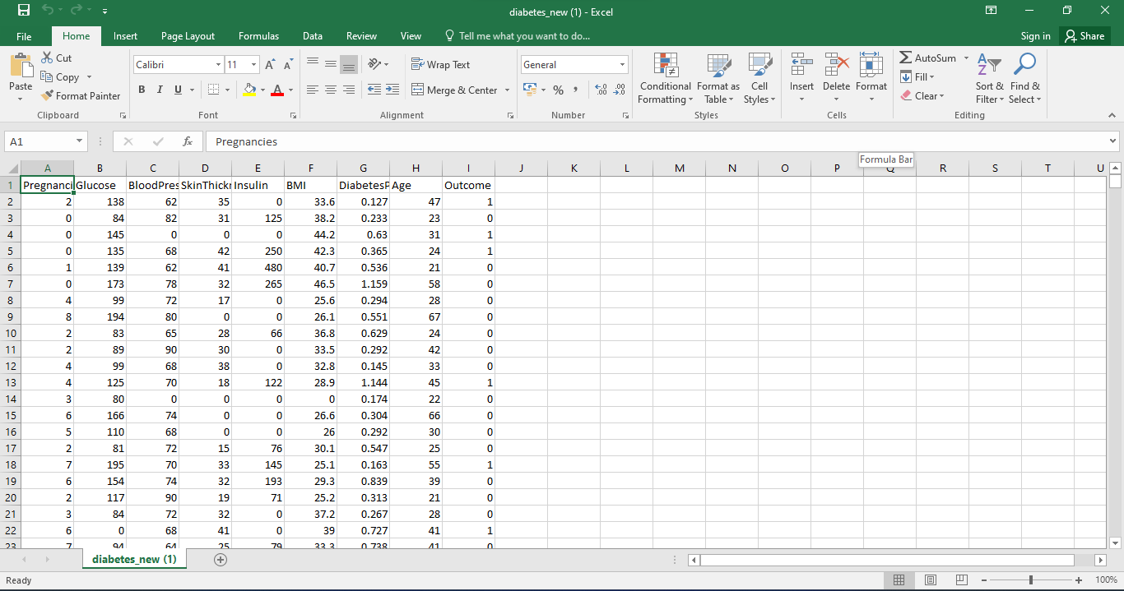
MODULE 1: Diabetes Dataset
Step:1 Collection of data
In this step, we'll gather the data needed to train the machine learning model. The dataset includes features such as Pregnancies, Glucose, BloodPressure, SkinThickness, Insulin, BMI, DiabetesPedigreeFunction, and Age, which are used to predict diabetes. We’ll preprocess this data and use it to train the model.

Slide 11
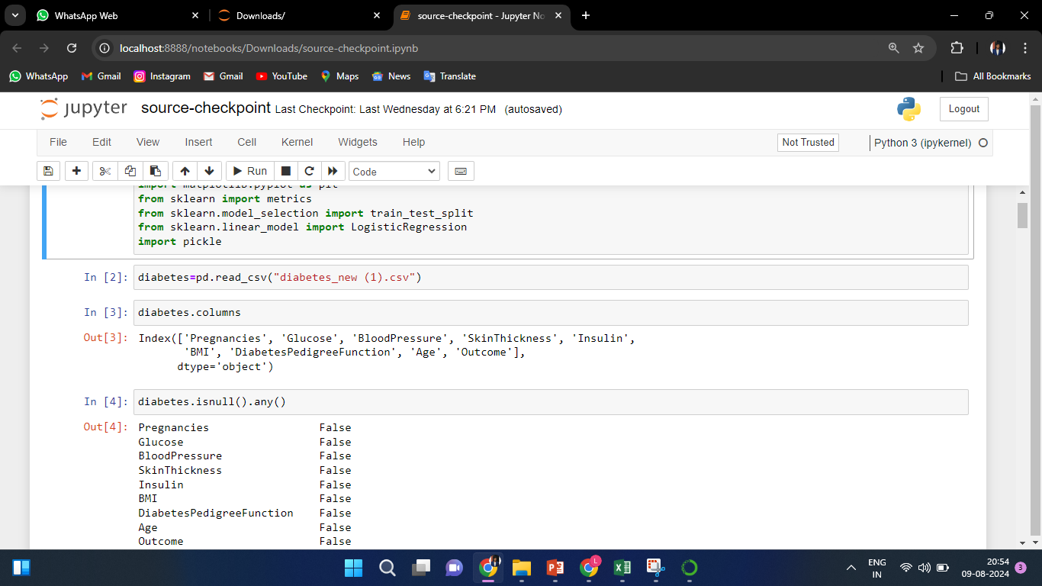
Step 2: Processing the data
.
The data cleaning process for the diabetes.csv file involves handling missing values by imputation or removal, correcting data types to ensure accuracy, and removing duplicates. It also includes standardizing data formats, detecting and addressing outliers, and normalizing numerical values to prepare the dataset for effective analysis and modeling.

Slide 12
Module 2:Decision Tree Algorithm
A Decision Tree is a popular machine learning algorithm used for classification and regression tasks. In the decision tree algorithm provides a structured approach to make predictions based on input features. Here’s how it is typically used:
Dataset Overview:
The dataset might include features such as Pregnancies, Glucose, BloodPressure, SkinThickness, Insulin, BMI, DiabetesPedigreeFunction, and Age and the target variable is usually whether or not the patient has diabetes, often represented as a binary classification (e.g., 0 for no diabetes, 1 for diabetes).
Data Preparation:
Preprocessing: Clean the dataset by handling missing values, normalizing or scaling features, and encoding categorical variables if necessary.
Building the Decision Tree:
Training: The decision tree algorithm constructs a tree-like model of decisions and their possible consequences. Each internal node of the tree represents a test on an attribute (e.g., is Glucose greater than a certain value?), each branch represents the outcome of the test, and each leaf node represents a class label (e.g., diabetes or no diabetes).
Model Evaluation:
Accuracy: Evaluate the model using metrics such as accuracy, precision, recall, and F1 score on the test set. This helps determine how well the decision tree predicts diabetes based on new, unseen data.
Prediction:
Applying the Model: Use the trained decision tree model to make predictions on new data. For a given patient’s features, the model will traverse the tree to predict whether the patient is likely to have diabetes.

Slide 13
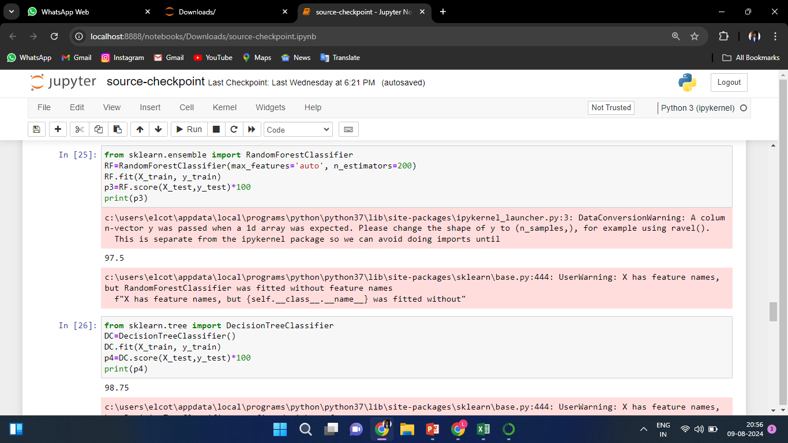
Step 1: Using Decision Tree algorithm

Slide 14
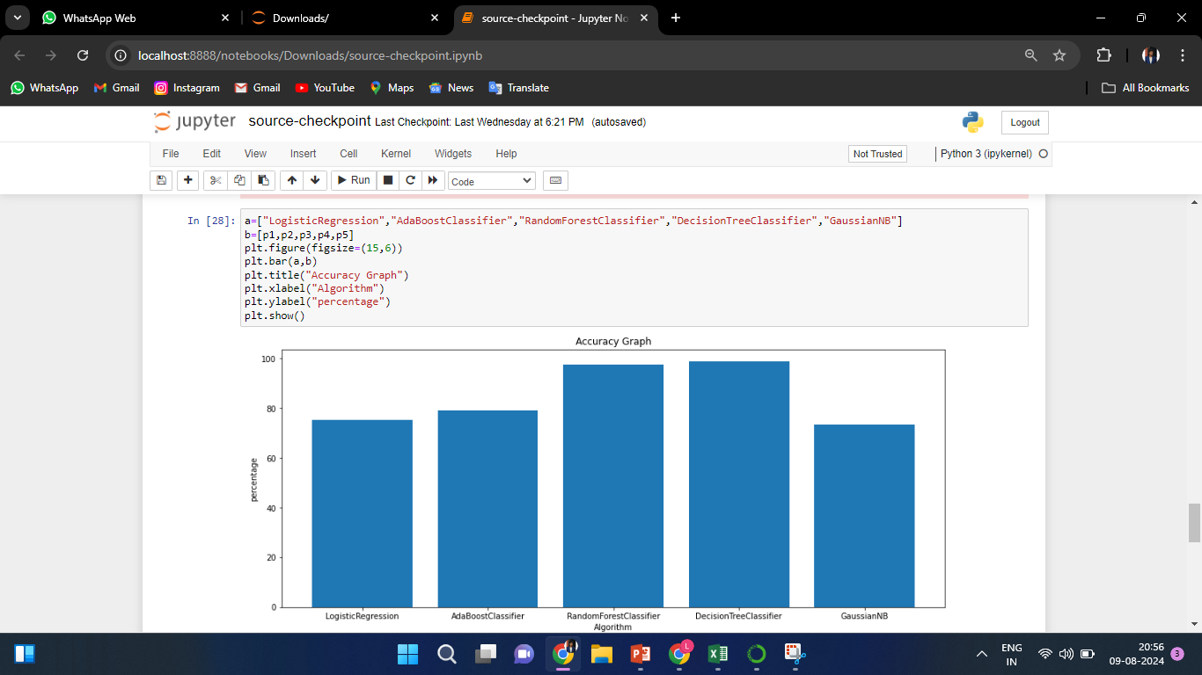
Step 2: The Output

Slide 15
IMPLEMENTATION
Architecture Diagram
Data –Flow Diagram
Use Case Diagram
Class Diagram
Activity Diagram
Sequence Diagram
Collaboration Diagram(If applicable)
E-R Diagram

Slide 16
Architecture Diagram
Preprocess data
Machine learning
Performance analysis
Fill the best model using flask
Original data
Web application
Human interaction
And prediction

Slide 17
Data –Flow Diagram
Dataset division (train and test dataset
Classification of diabetic and non diabetic patients
Load data set
Proposed algorithm
Prediction accuracy

Slide 18
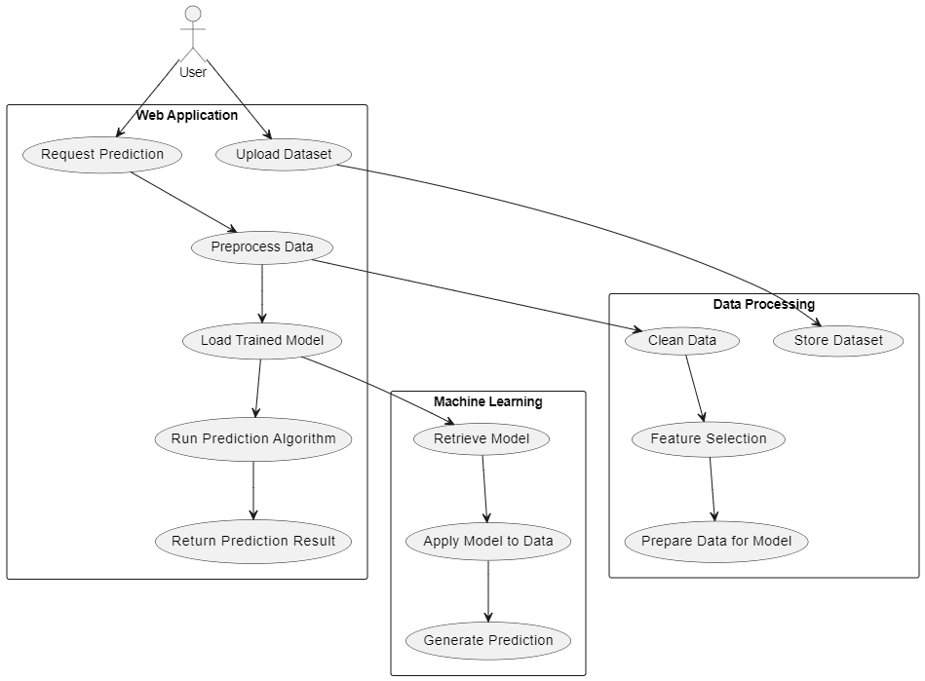
Use Case Diagram

Slide 19
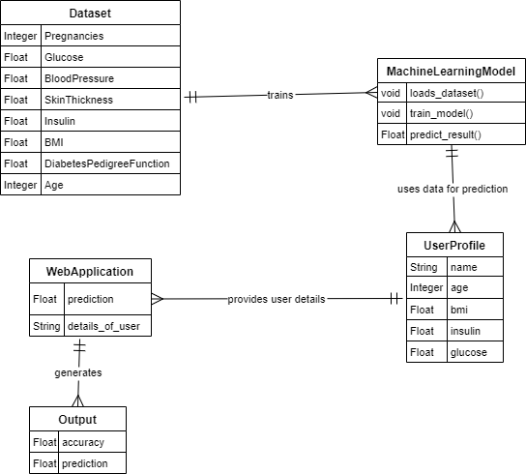
Class Diagram

Slide 20
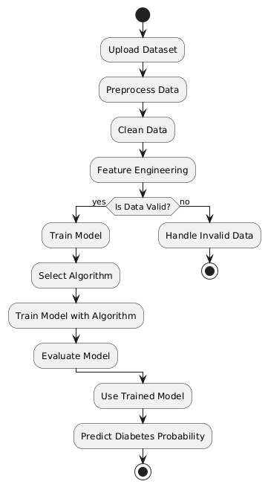
Activity Diagram

Slide 21
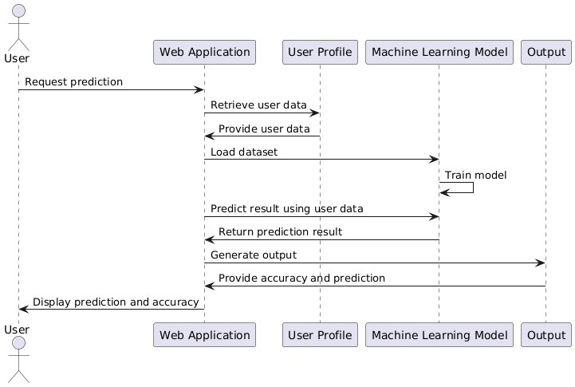
Sequence Diagram

Slide 22
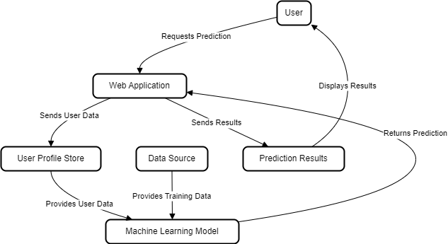
E-R Diagram

Slide 23
TESTING
UNIT TESTING
INTEGRATION TESTING
FUNCTIONAL TESTING
WHITE BOX TESTING
BLACK BOX TESTING

Slide 24
UNIT TESTING
Data Input Validation: Unit tests should verify that the data input modules correctly handle valid and invalid inputs. For instance, tests could ensure that out-of-range values or incorrect data formats are flagged appropriately.
Preprocessing Accuracy: Testing preprocessing algorithms is crucial to ensure that data transformations (like normalization or encoding) are applied correctly. Unit tests can check that data is cleaned and formatted as expected.
Model Accuracy: For prediction models, unit tests can evaluate whether the model produces consistent results given the same input. Tests should also verify that the model adheres to expected performance metrics and handles edge cases effectively.
Output Verification: Output interfaces need to be tested to ensure they correctly translate prediction results into user-friendly formats. Unit tests can check for accurate representation of results and proper handling of different output scenarios.
.
INTEGRATION TESTING
Verify Data Flow: Ensure that data flows correctly between the collection, processing, and prediction components. For instance, integration tests can confirm that data collected from the user interface reaches the predictive algorithms accurately and in the expected format.
Test Interaction Between Modules: Assess how well different modules interact. This might involve testing scenarios where data is processed by multiple components, ensuring that each module correctly handles the data it receives .
Check Error Handling: Validate that the system handles errors gracefully when one component fails or produces unexpected output.
Assess Performance: Evaluate the performance of the system under integrated conditions. This includes ensuring that the system maintains acceptable response times and accuracy when all components are functioning together.

Slide 25
SYSTEM TESTING
Verify System Functionality: Ensure that the diabetes predictor performs all intended functions correctly, including data input, processing, risk prediction, and output presentation.
Assess Performance: Evaluate the system's performance under various conditions, including normal load, peak load, and stress scenarios, to ensure it operates efficiently and reliably.
Check Usability: Confirm that the system is user-friendly and intuitive. This involves testing the user interface and overall user experience to ensure that users can interact with the system effectively and understand the results.
Validate Security: Ensure that the system protects sensitive patient data and adheres to privacy and security standards. This includes testing for vulnerabilities and verifying that appropriate security measures are in place.
FUNCTIONAL TESTING
Verify Core Functions: Ensure that all core functionalities of the diabetes predictor are working correctly. This includes data input, risk calculation, and result output.
Validate Business Logic: Confirm that the business rules and algorithms used in the predictor align with medical guidelines and accurately assess diabetes risk.
Check User Interactions: Assess how well the system handles user interactions, such as data entry, result display, and user feedback mechanisms.
Ensure Data Accuracy: Verify that the system correctly processes and interprets input data to generate accurate risk predictions.

Slide 26
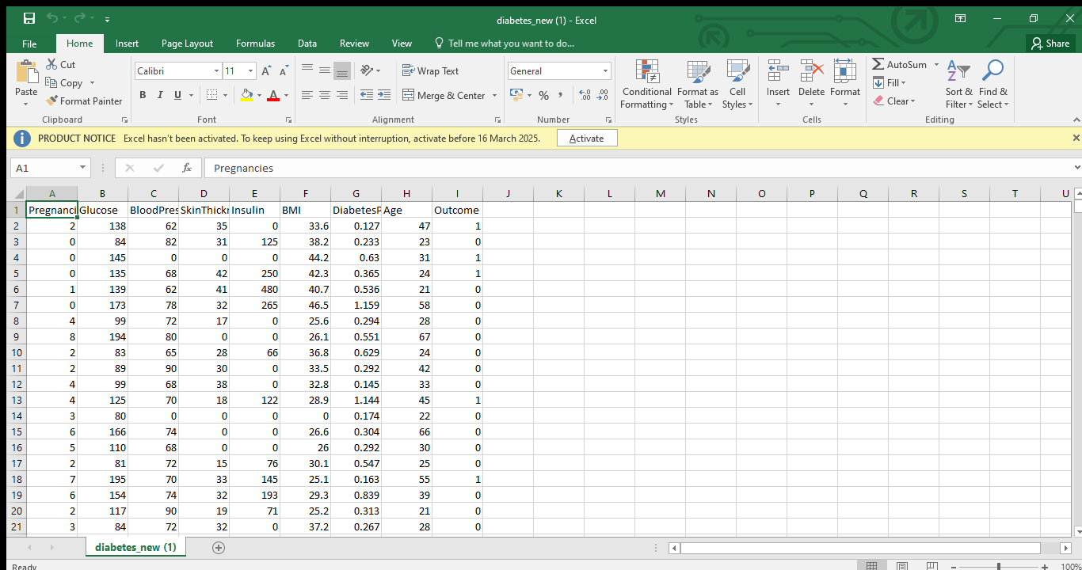
INPUT AND OUTPUT
Diabetes Dataset

Slide 27
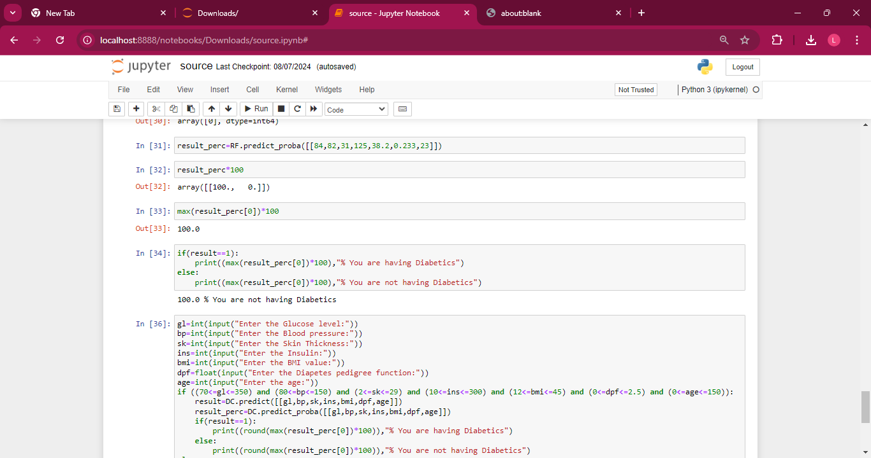
SOURCE CODE

Slide 28
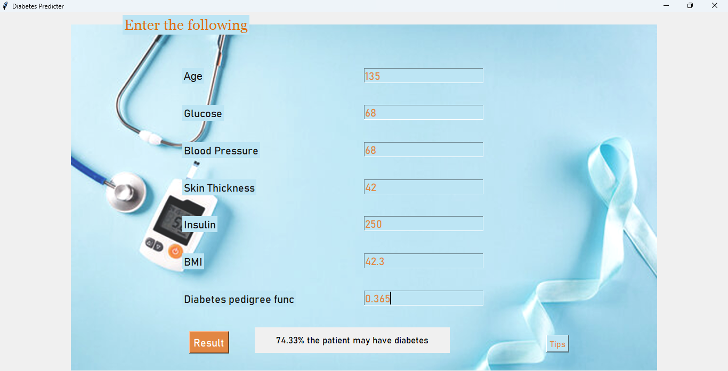
OUTPUT
Web Application

Slide 29
CONCLUSION
Aim: To validate the functionality of a diabetes predictor system, ensuring it accurately processes data, applies predictive algorithms, and delivers reliable risk assessments.
Problem Statement: The challenge is to ensure that the diabetes predictor system performs its core functions correctly, handles user inputs and errors effectively, and provides accurate predictions and a user-friendly interface.
Verification of Core Functions: Functional testing confirms that each part of the system, including data input, risk calculation, and result output, operates as intended.
Accuracy of Predictive Algorithms: Ensures that the algorithms used for risk assessment are correctly implemented and produce reliable results based on diverse input scenarios.
User Interface and Experience: Validates that the user interface is intuitive and all interactive elements function properly, providing a positive user experience.
Error Handling: Assesses the system's ability to manage erroneous or incomplete data gracefully, ensuring meaningful error messages and robust failure handling.
Improvement of Reliability: Identifies and fixes defects related to system functions, enhancing overall stability and performance.
In Conclusion, functional testing is essential for ensuring that a diabetes predictor system meets its design goals, delivers accurate assessments, and provides a reliable and user-friendly experience. By addressing the core functionalities and potential issues, functional testing helps in creating a robust tool for early diabetes risk detection.

Slide 30
FUTURE ENHANCEMENTS
Personalized Dietary Recommendations: Based on the risk level, the system could suggest tailored food habits that may help in managing or reducing the risk of diabetes. For instance, users with a high prediction percentage could receive advice on reducing sugar and carbohydrate intake while incorporating more fiber-rich foods.
Exercise and Lifestyle Guidance: Provide users with lifestyle recommendations, such as specific exercise routines or daily steps goals, that align with their diabetes risk levels to support overall health improvement.
Integration with Wearable Health Devices: Enable the application to connect with wearable devices (e.g., fitness trackers) to collect real-time health data like glucose levels, heart rate, and physical activity. This data can refine predictions and offer ongoing health monitoring.
Risk Monitoring and Alerts: For users at higher risk, implement a system of periodic check-ins and alert notifications to encourage regular health checks or medical consultations.
Health Progress Tracking and Reports: Allow users to track changes in their health over time with visual progress reports, so they can monitor the impact of lifestyle changes and understand their risk trajectory.

Slide 31
SOCIETAL IMPACT OF PROJECT
Improved Public Health: Reduces complications by enabling early diabetes detection and intervention.
Cost Savings: Lowers healthcare expenses by promoting prevention over treatment.
Increased Accessibility: Provides at-risk individuals with a tool for early diagnosis, especially in underserved areas.
Patient Empowerment: Offers personalized health insights and lifestyle recommendations, encouraging proactive health management.
Advancement in Digital Health: Contributes to AI-driven healthcare innovation for public health improvement.
.Support for Healthcare Providers: Assists clinicians with early risk identification and informed patient guidance.
Promotion of Preventative Health: Inspires a preventative approach to health in the community.
Data-Driven Awareness: Gathers insights that support public health campaigns and education on diabetes prevention.

Slide 32
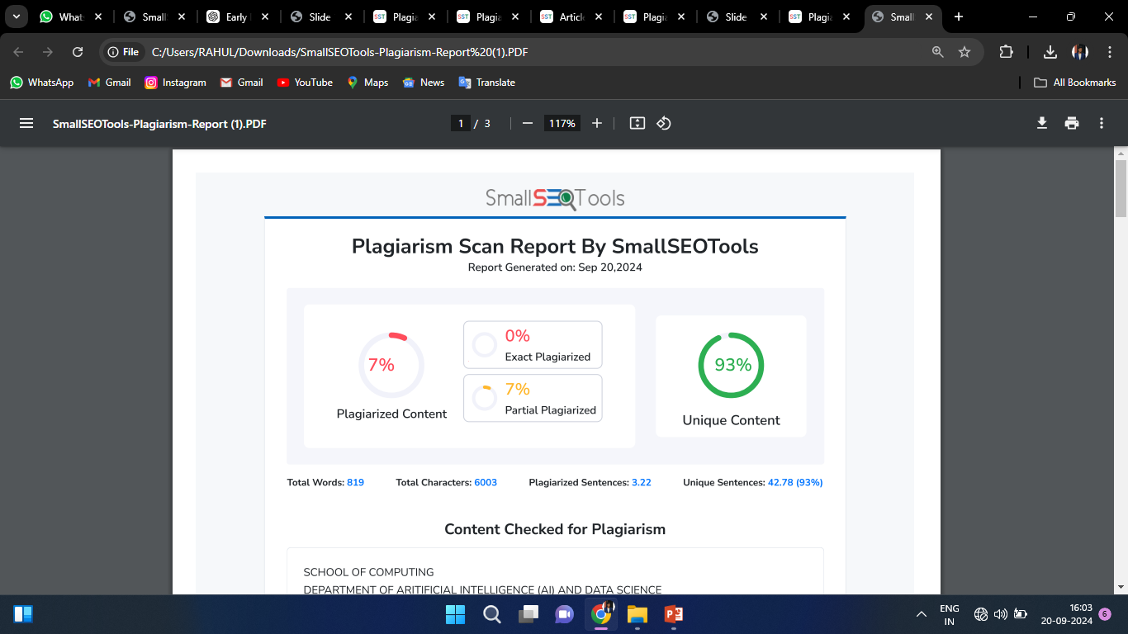
Plagiarism Report of PPT

Slide 33
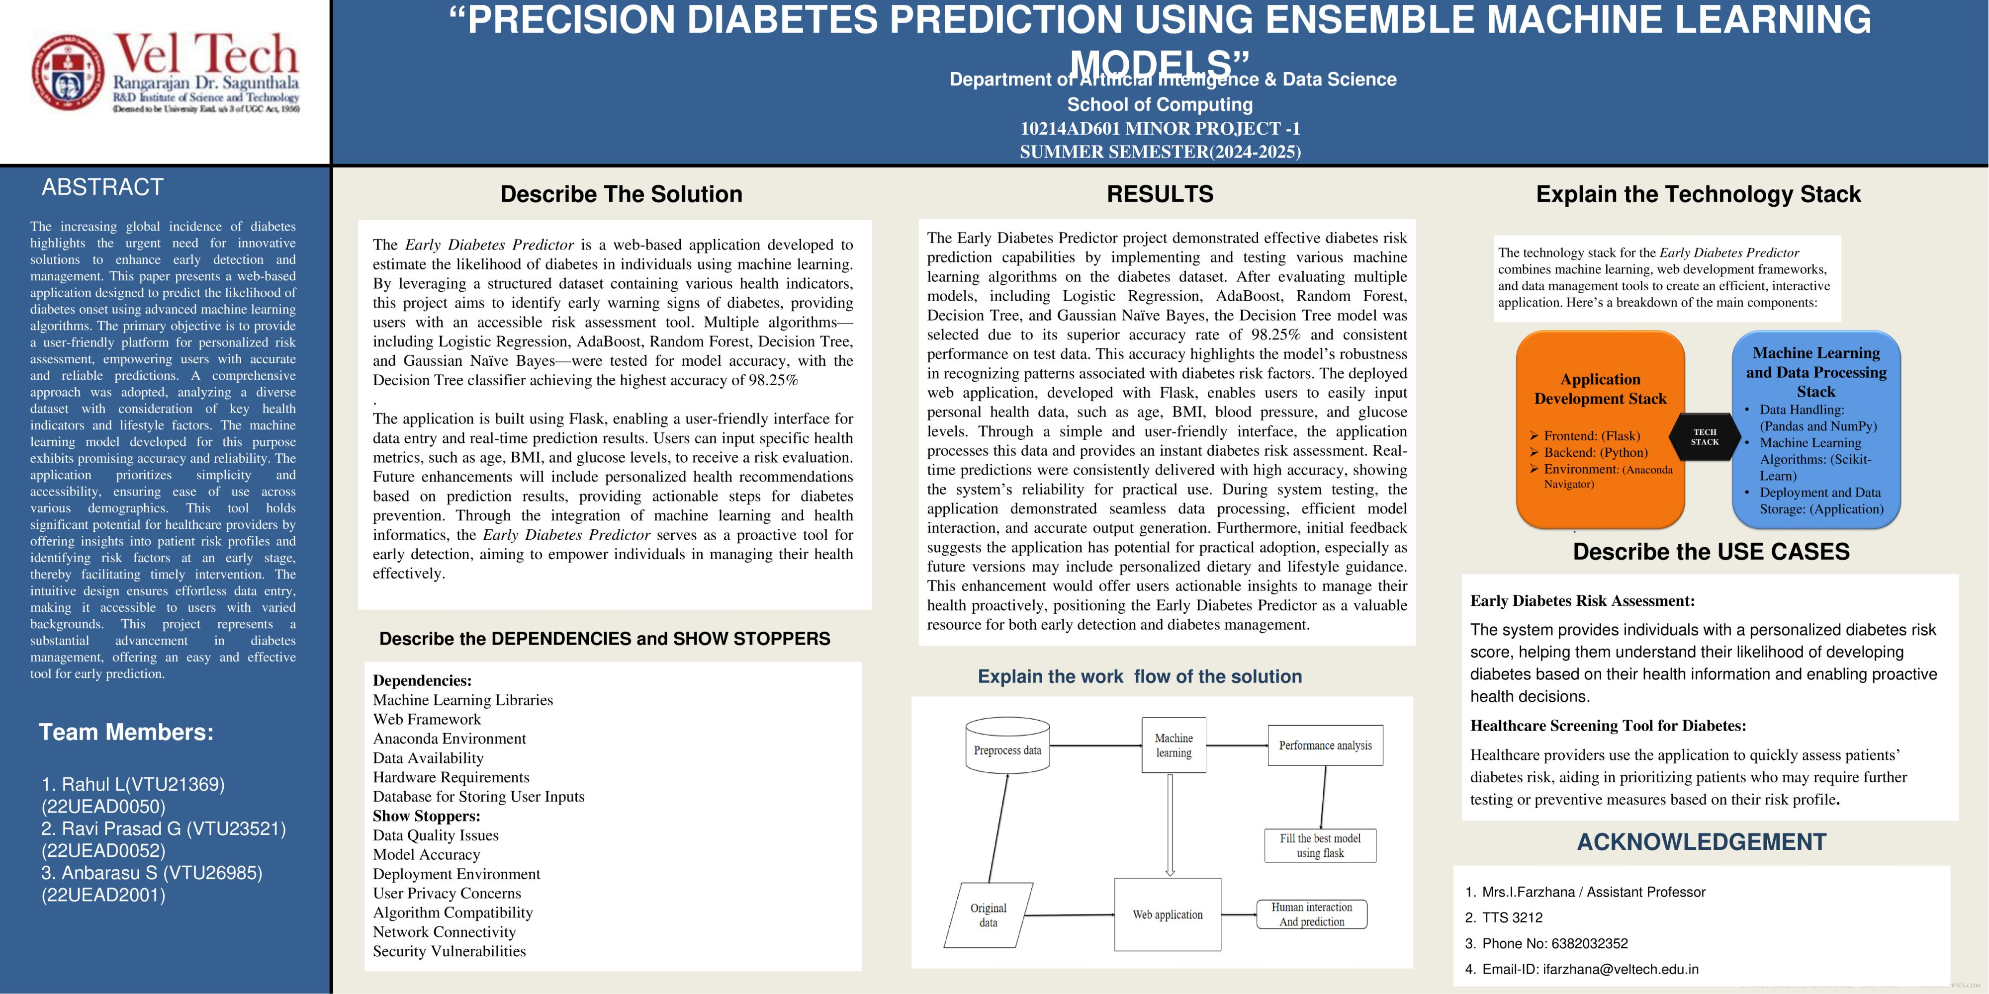
POSTER PRESENTATION

Slide 34
Web references/video links
https://www.kaggle.com/datasets/uciml/pima-indians-diabetes-database
https://www.geeksforgeeks.org/decision-tree/
https://www.kaggle.com/code/ahmetcankaraolan/diabetes-prediction-using-machine-learning
https://www.analyticsvidhya.com/blog/2022/01/diabetes-prediction-using-machine-learning/
https://www.sciencedirect.com/science/article/pii/S1877050920300557
.

Slide 35
REFERENCES
[1] D. W. Wang, J. H. Chen, and S. L. Wong, “Early Prediction of Type 2 Diabetes Using Machine Learning Techniques,” in Proceedings of the IEEE International Conference on Healthcare Informatics (ICHI), New York, NY, USA, 2021, pp. 155-163.
[2] J. S. Lee, H. K. Kim, and R. H. Zhao, “Risk Prediction Models for Diabetes Mellitus: A Review,” in Proceedings of the IEEE International Conference on Bioinformatics and Biomedicine (BIBM), Miami, FL, USA, 2019, pp. 455-461.
[3] A. Patel and M. S. Ahmed, “Integration of Wearable Health Data for Early Diabetes Prediction,” in IEEE Transactions on Biomedical Engineering, vol. 68, no. 2, pp. 432-440, Feb. 2021.
[4] X. L. Zhang and Y. J. Lin, “Data Fusion Techniques for Predicting Diabetes Risk Using Electronic Health Records,” in Proceedings of the IEEE International Conference on Big Data (BigData), Seattle, WA, USA, 2020, pp. 2902-2911.
[5] L. A. Williams, R. T. Davidson, and H. W. Yu, “Advanced Algorithms for Early Diabetes Detection in Large Datasets,” in IEEE Journal of Biomedical and Health Informatics, vol. 24, no. 5, pp. 1367-1375, May 2020.
[6] S. Gupta, P. S. Rao, and M. K. Singhal, “Predictive Analytics for Diabetes Management: A Survey of Methods and Applications,” in Proceedings of the IEEE International Conference on Data Science and Advanced Analytics (DSAA), Paris, France, 2018, pp. 341-350.

Slide 36
THANK YOU

